Slide 1
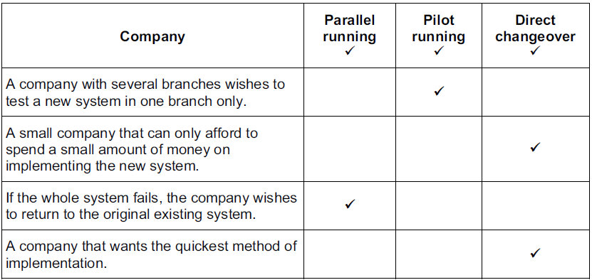
Tick the most appropriate method of implementing a new system for each company.

Slide 2
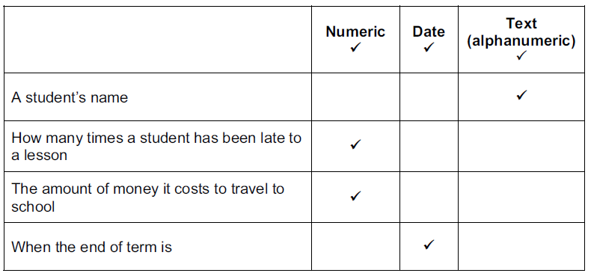
When creating a database, it is important to assign the correct data type to each field.
Tick the most appropriate data type for each of the following items of data.

Slide 3
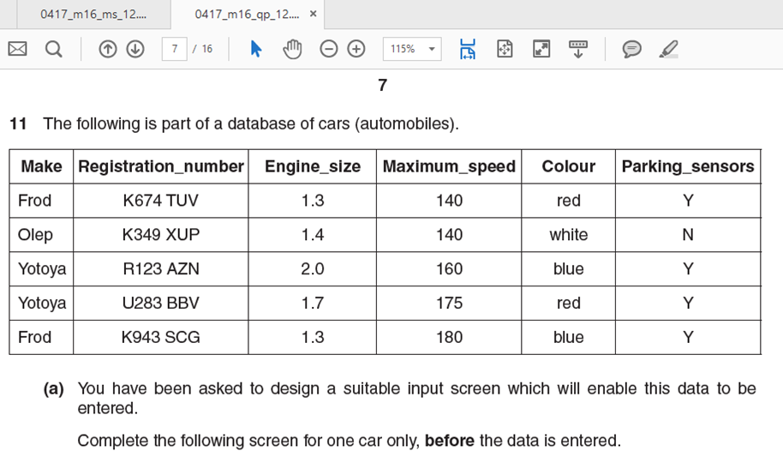
Appropriate spacing for each field (1 mark)
Forward/backward buttons/save (submit) - must have at least two navigation aids. (1 mark)
Candidate attempts for information to fill the page AND is clearly a screen form (1 mark)
All six of the given fields – 3 marks
Five of the given fields – 2 marks
Four of the given fields – 1 mark

Slide 4
For each of the following fields, name and describe the most appropriate validation check. Assume that the values given in the numeric fields include the minimum and maximum values for those fields.
Registration_number
format/picture check
must consist of one letter, three digits, space, three letters
Maximum_speed
range check
must be >=140 and <=180

Slide 5
A large company has asked a systems analyst to research the current system.
Describe how this will take place.
Users of the current system will be interviewed
Users of the current system will be asked to complete questionnaires
Users of the current system will be observed using the system
Existing documents will be examined
Management will be interviewed
Management will be asked to complete questionnaires
Describe what information will be identified as a result of this research.
Inputs of the current system
Outputs from the current system
Processing in the current system
Problems/limitations with the existing system/improvements required
The user requirements
The information requirements

Slide 6
A company is going to introduce a new computer system.
The company employs drivers to deliver orders and they are rarely in the office for more than a few minutes. The office secretaries process the orders and dislike being interrupted. A manager is in charge of the current system and appointments can be made to see her.
Name three methods of researching the current system other than from examining documents. Identify the workers that each method would be most suitable for. Each method will be used with a different type of worker.
Interview
Manager
Questionnaire
Drivers
Observation
Secretaries

Slide 7
A company is going to introduce a new computer system.
The company employs drivers to deliver orders and they are rarely in the office for more than a few minutes. The office secretaries process the orders and dislike being interrupted. A manager is in charge of the current system and appointments can be made to see her.
After the current system has been researched, the new system will be designed. This means that the file structure will be designed.
Identify three items of a flat file structure which will form part of this activity.
Data type for each field
Appropriate field names
Validation rules
Field lengths
Field descriptions

Slide 8
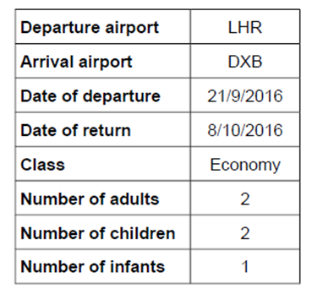
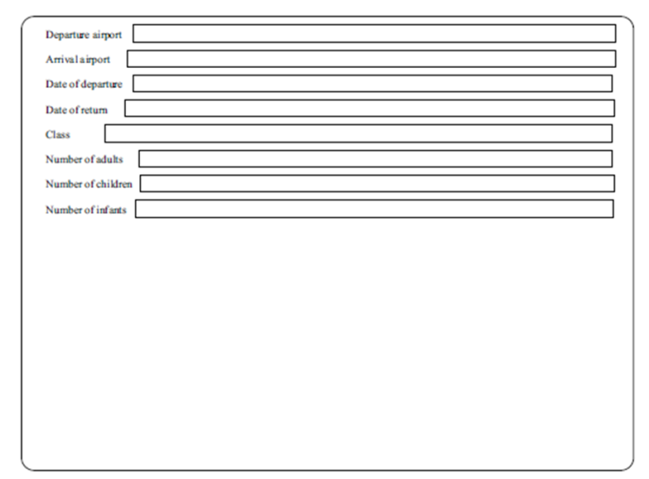
An airline company allows customers to book flights online. Here is an example of the data a customer is asked to type in when they search for a suitable flight, together with a typical entry. There are three types of class: Economy, Business and First.
Evaluate this form regarding the ease of entering data
The fields which require completion are all included.
Fields are clearly labelled
The space allowed for data entry is more than adequate
On the other hand the form could be improved by having:
Appropriate space for each field
Screen more spread out
Larger font for field names
Drop down list for Number of adults, Number of children, Number of infants date of return/date of departure & Class
Separate drop down lists for dd/mm/yyyy
Navigation buttons could be included to move between records
Drop down list for Number of adults, Number of children, Number of infants

Slide 9
An airline company allows customers to book flights online. Here is an example of the data a customer is asked to type in when they search for a suitable flight, together with a typical entry. There are three types of class: Economy, Business and First.
Explain why it would not be appropriate for a format check to be used on the dates as given in the example data.
A format check ensures that data is in a specific format…
…such as two digits for day, two digits for month and four digits for year
In the table above the date would be rejected by this check as it has one digit for the month in one example two in the other
In the table above the date would be rejected by this check as it has two digits for the day in one example and one in the other

Slide 10
Name and describe three methods of implementing a new computer system. For each one describe the type of situation where each method might be used.
Direct changeover
New system replaces existing system immediately/overnight
A small organisation which can afford to lose data/where system needs to be up and running very quickly/where the new system has been thoroughly tested
Parallel running
New system runs alongside/together with existing system
An organisation with large amounts of data which would take too long to re-enter / cannot
afford to lose data/where time taken/cost to implement is not an issue/where the new system needs to be thoroughly tested
Phased implementation
New system is implemented part by part
An organisation where there are clearly defined separate processes/where the new system
needs to be thoroughly tested
Pilot running
(Whole) system is implemented in one branch/one office (at a time) [1]
An organisation where there are several branches all doing the same work)/where the new
system needs to be thoroughly tested

Slide 11
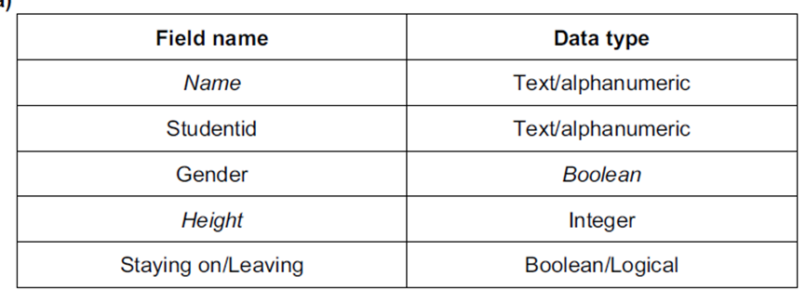
Maria is the principal of the International Municipal school. She has employed Paulo, a systems analyst, to create a new database system to store records of her final year IGCSE students.
Examples of the details of the students which will be stored are:
Velia Grimaldi, A3058, Female, 161, Leaving
Giuseppe Campo, A3072 , Male, 177, Staying on to 6th form
Nicola Donati, B3085, Female, 173, Staying on to 6th form
Giovanni Agnelli, C3102, Male, 172, Leaving
Complete the following table by entering the field names and most appropriate data type for each field.

Slide 12
Paulo wishes to save storage space. He does not change the Name field, but decides that two other fields could have their data shortened.
Apart from the Name field, identify the two other fields and describe how the contents will be
shortened.
Field 1: Gender
Shortened form 1 M for male, F for female
Field 2 Staying on to 6th form /Leaving
Shortened form 2 S/6 for Staying on to 6th form, L for Leaving

Slide 13
Different types of test data are used to test a newly developed system.
Complete the following sentences.
(a) Data which is of the correct type is called
Normal data
(b) Data which is outside a given range is called
Abnormal data
(c) Data which is at the boundaries of a given range is called
Extreme data
(d) Data which has been used with the current system and the results are known is called
Live data

